Slide 1


Intelligent Robotics Presentation
Università degli Studi di Padova
Dipartimento di ingegneria dell’informazione
Professor: Emanuele Menegatti
Group members:
Edoardo Bastianello
Stefano Binotto
Gionata Grotto
DIPARTIMENTO
DI INGEGNERIA
DELL’INFORMAZIONE
Notes:
‹#›

Slide 2
Assignment 1
robot_srv.cpp
controller_client.cpp
Move.action
Notes:
‹#›

Slide 3
Navigation
We used the Move_base action server to manage the navigation.
While the robot perform the navigation it updates the feedback that it’s then read by the client. We implemented three states:
moving
stopped
turning
The feedback will be turning if the curve of the trajectory of the robot is greater than 8 degrees.
We also implemented a timeout to check if the robot didn’t manage to get to the final pose.
Notes:
‹#›

Slide 4
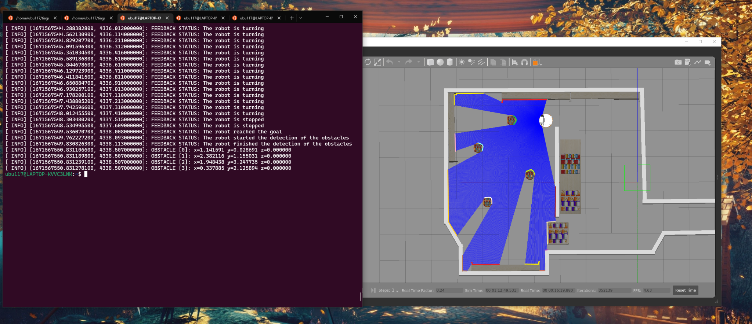


Detection of movable obstacles
The detection of the movable obstacles is subdivided in 3 parts:
Subdivide the detected points in connected sections;
Find the most suitable candidates as movable obstacles;
Find the center of each detected movable obstacle.
Notes:
‹#›

Slide 5
Detection – Subdivide in connected sections (1)
Get the detected points;
Discard the first 19 points and the last 18 detected points;
Subdivide the remaining points in different connected sections
Connected section: set of consequent detections having distance between them lower than 0.25.
Notes:
‹#›

Slide 6
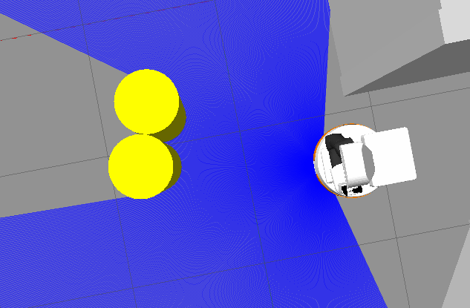
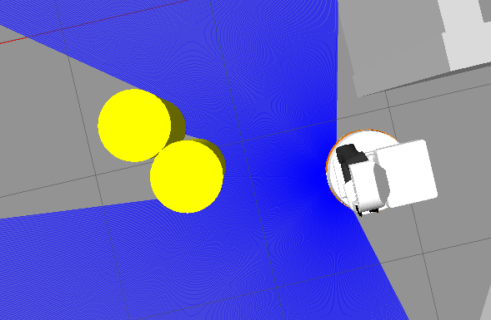
Detection – Subdivide in connected sections (2)
Assumption: the movable objects aren’t attached to each other.
Notes:
‹#›

Slide 7
Detection – Compute centers of circles
Compute the centers of the obstacles using three points of the specific detected obstacle.
(x – h)² + (y - k)² = r²
We assumed that each section on which this method will be applied is a circle even if is not.
Initially we thought a different approach to compute the solution that, however, worked only if the robot saw all the movable obstacle.
Notes:
‹#›

Slide 8
Detection – Ideas
Once we found the connected sections, to understand which of them were movable obstacles we had two main ideas:
Angular Coefficient approach
Computer Vision approach
However we found a much simpler and more effective strategy.
Notes:
‹#›

Slide 9
Detection – Find the obstacles (1)
We cancel out those connected components which does not satisfy our upper and lower limits.
Assumption: we know the diameter of the movable obstacle.
Notes:
‹#›

Slide 10
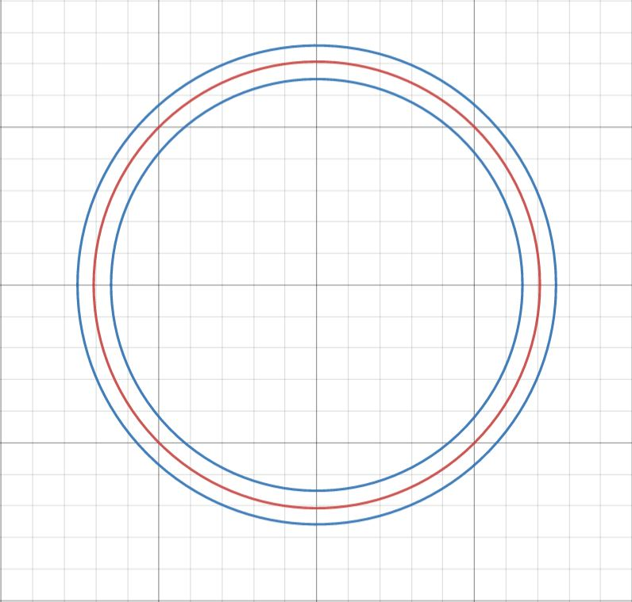
Detection – Find the obstacles (2)
After computing the center of the hypothetical circle, we check whether each point of the connected component belongs to its circumference.
Assumption: we know the radius of the movable obstacles and we assume that the connected component is a circle.
Notes:
‹#›

Slide 11
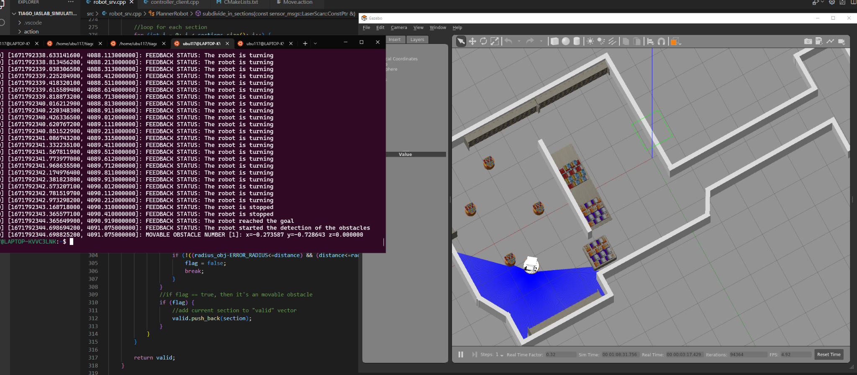
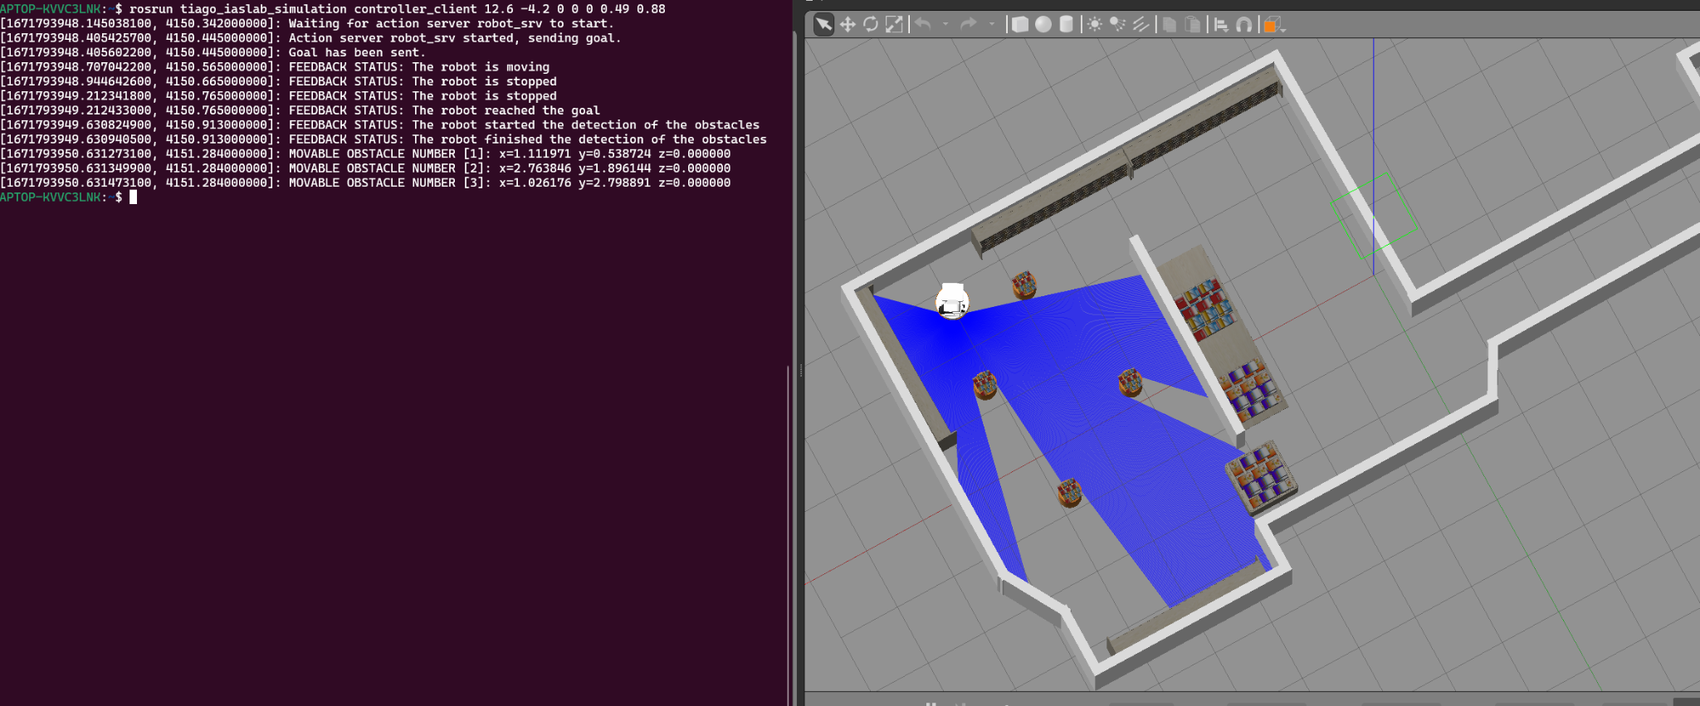
Detection – Borderline Cases
Our method performs generally well in the closed environment provided in the simulation.
In our testing we found:
there was no false negative.
there may be a problem if two movable obstacles are attached.
Notes:
‹#›

Slide 12
Output examples
Notes:
‹#›

Slide 13
Assignment 2
Objs.srv
Human_node.cpp
Move.action
robot_srv.cpp
client_human_navigate.cpp
srv_detect.srv
detection_server.cpp
pickObj.srv
pick_server.cpp
placeObj.srv
place_server.cpp
Notes:
‹#›

Slide 14
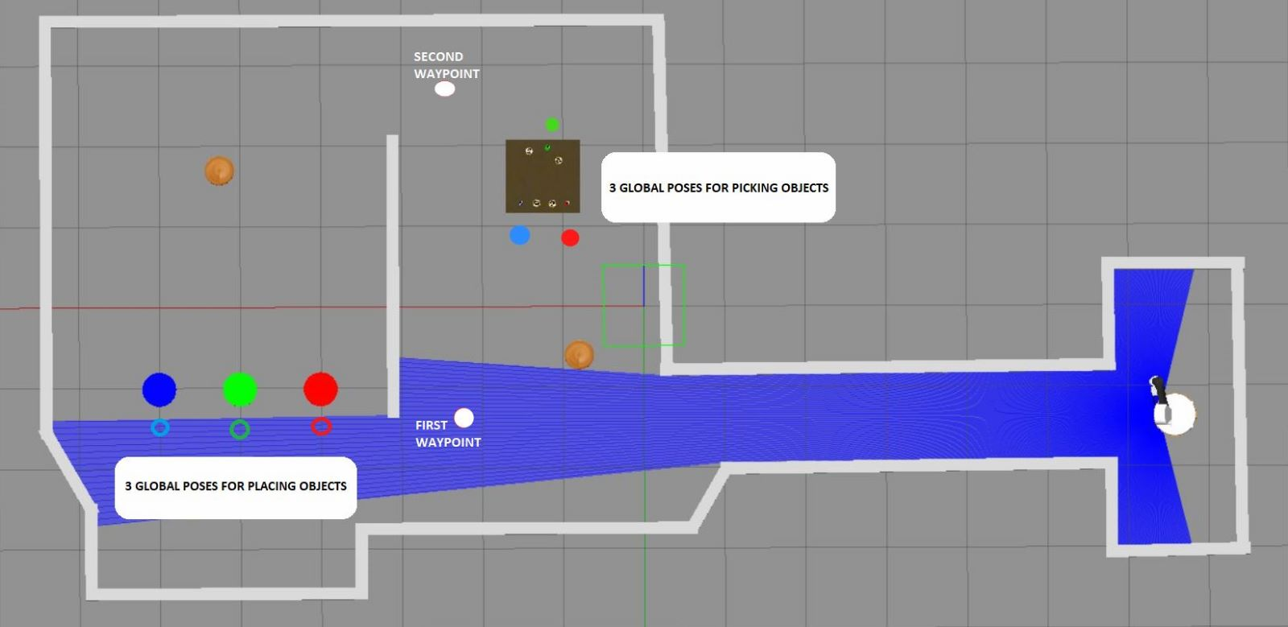
Navigation - Waypoints (1)
We defined 3 types of waypoints:
3 global poses for picking objects;
3 global poses for places objects;
2 additional waypoints to avoid getting stuck.
Notes:
‹#›

Slide 15
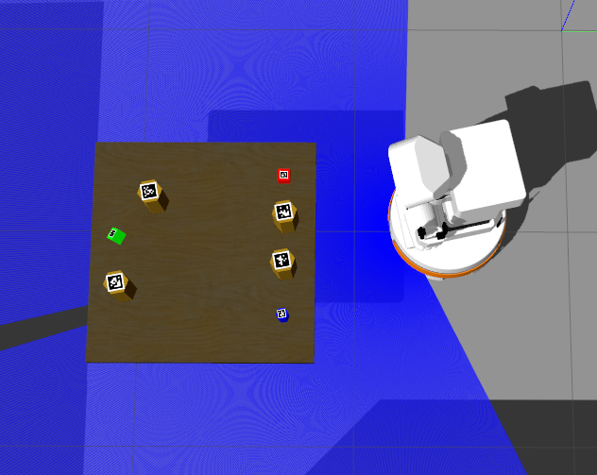
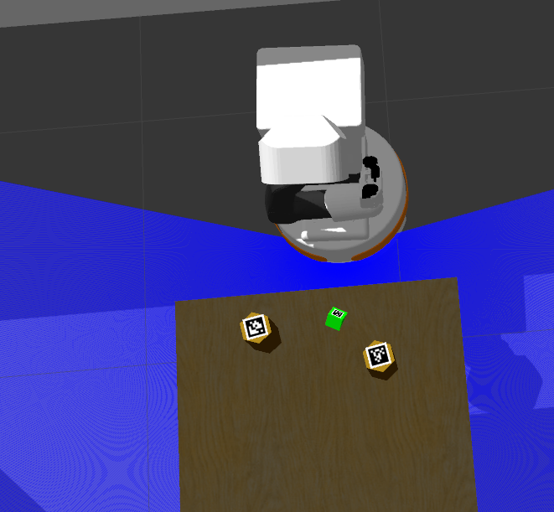
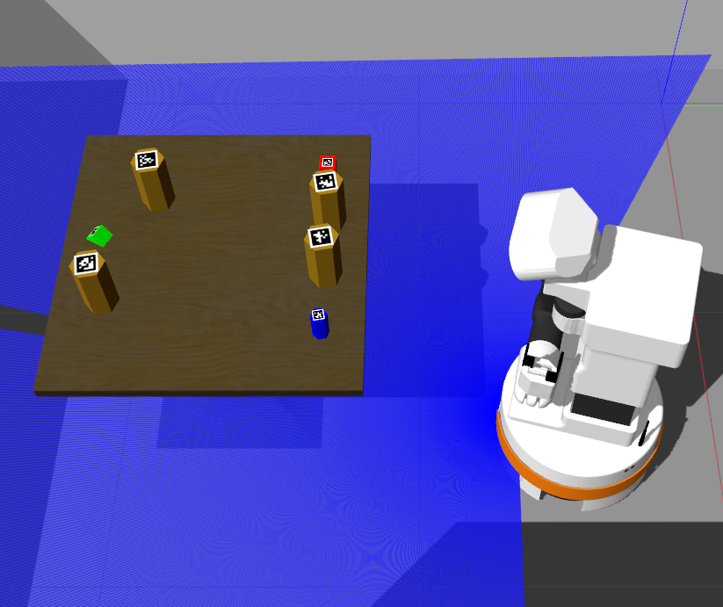
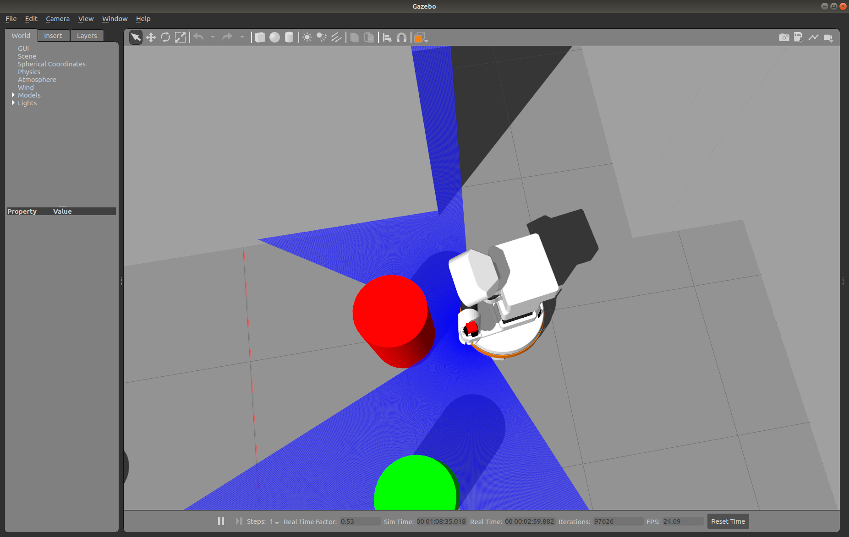
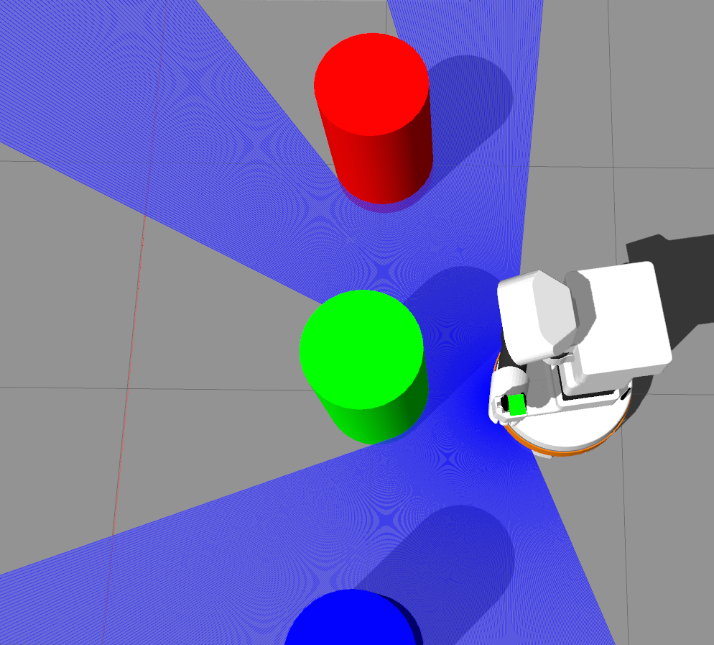
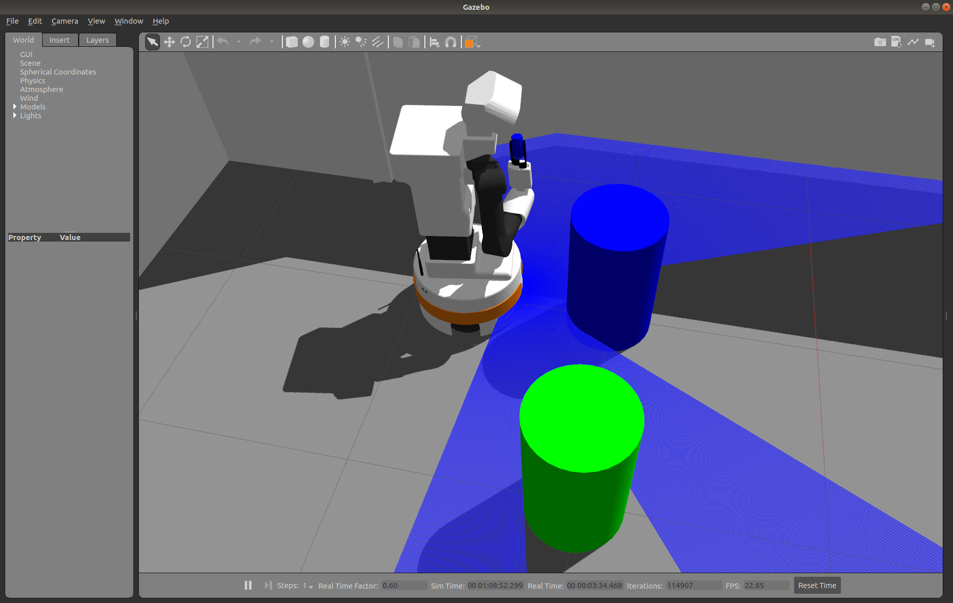
Navigation - Waypoints (2)
GLOBAL POSES TO PICK THE OBJECT
GLOBAL POSES TO PLACE THE OBJECT
Notes:
‹#›

Slide 16
Navigation - Sequence
The navigation is managed by following a sequence of waypoint that depends on the object to be picked:
Red or Blue:
first waypoint
red/blue global position for picking
red/blue global position for placing
Green:
first waypoint
second waypoint
green global position for picking
second waypoint
first waypoint
green global position for placing
Notes:
‹#›

Slide 17
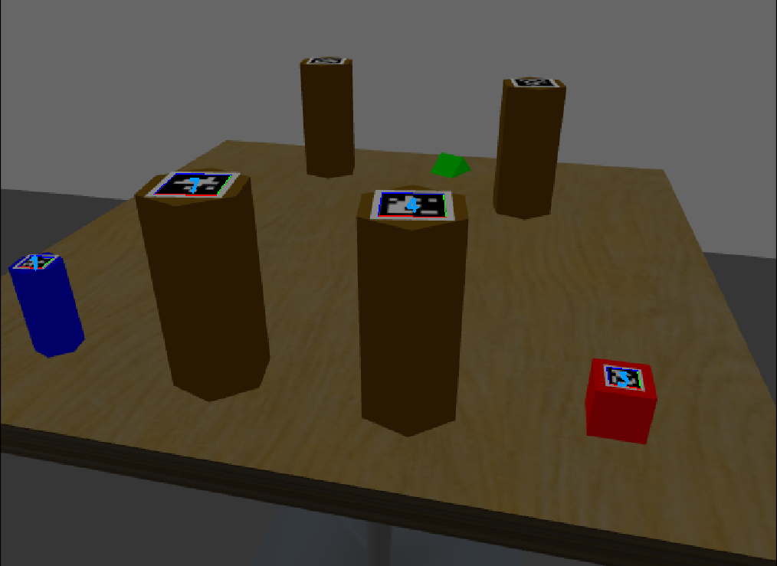
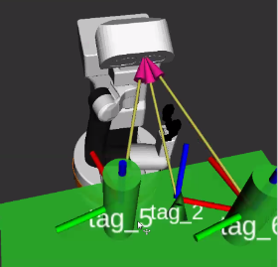
Detection – Camera
In order to maximize the performance of the detection and avoid collision we lowered the orientation of the camera.
We used the Image topic on rviz to
find the orientation that detect the maximum number of objects.
In order to maintain consistency we implemented that the robot have the same configuration while performing the detections.
Notes:
‹#›

Slide 18
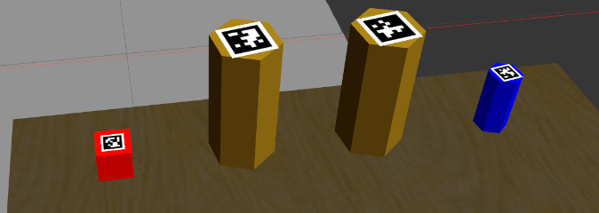
Detection – Apriltag
We used Apriltag to detect the positions of all the tags that are in the field of vision of the robot. Using the positions of these tags we were able to build the collision objects of all the relevant objects
Notes:
‹#›

Slide 19
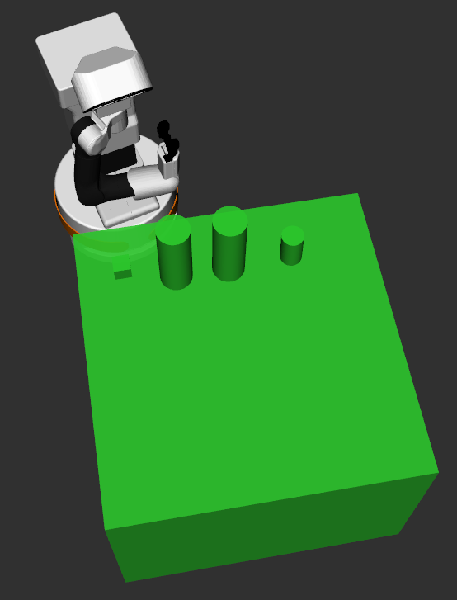
Detection – Create collision objects
In order to create the right collision objects we measured the dimensions of the objects using gazebo. The reference of the object is given by the tag applied on it.
Convert the values from the camera frame to /base_footprint
We enlarged the dimensions of the objects in order to prevent collisions. For every object we did the following actions:
cube: incremented every dimensions
triangle: considered as a cone. Furthemore, we had to rotate its reference because the tag wasn’t placed right above it like the other objects
hexagon (target and obstacle): incremented its radius and its height
table with objects: incremented mostly its width. We decided to build the collision objects of the table as a cube in order to avoid collisions during the movement of the arm
cylindrical tables: incremented the height and the radius
Notes:
‹#›

Slide 20
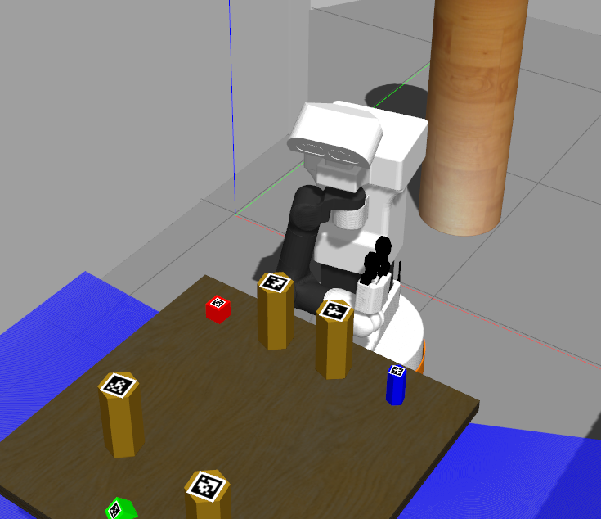
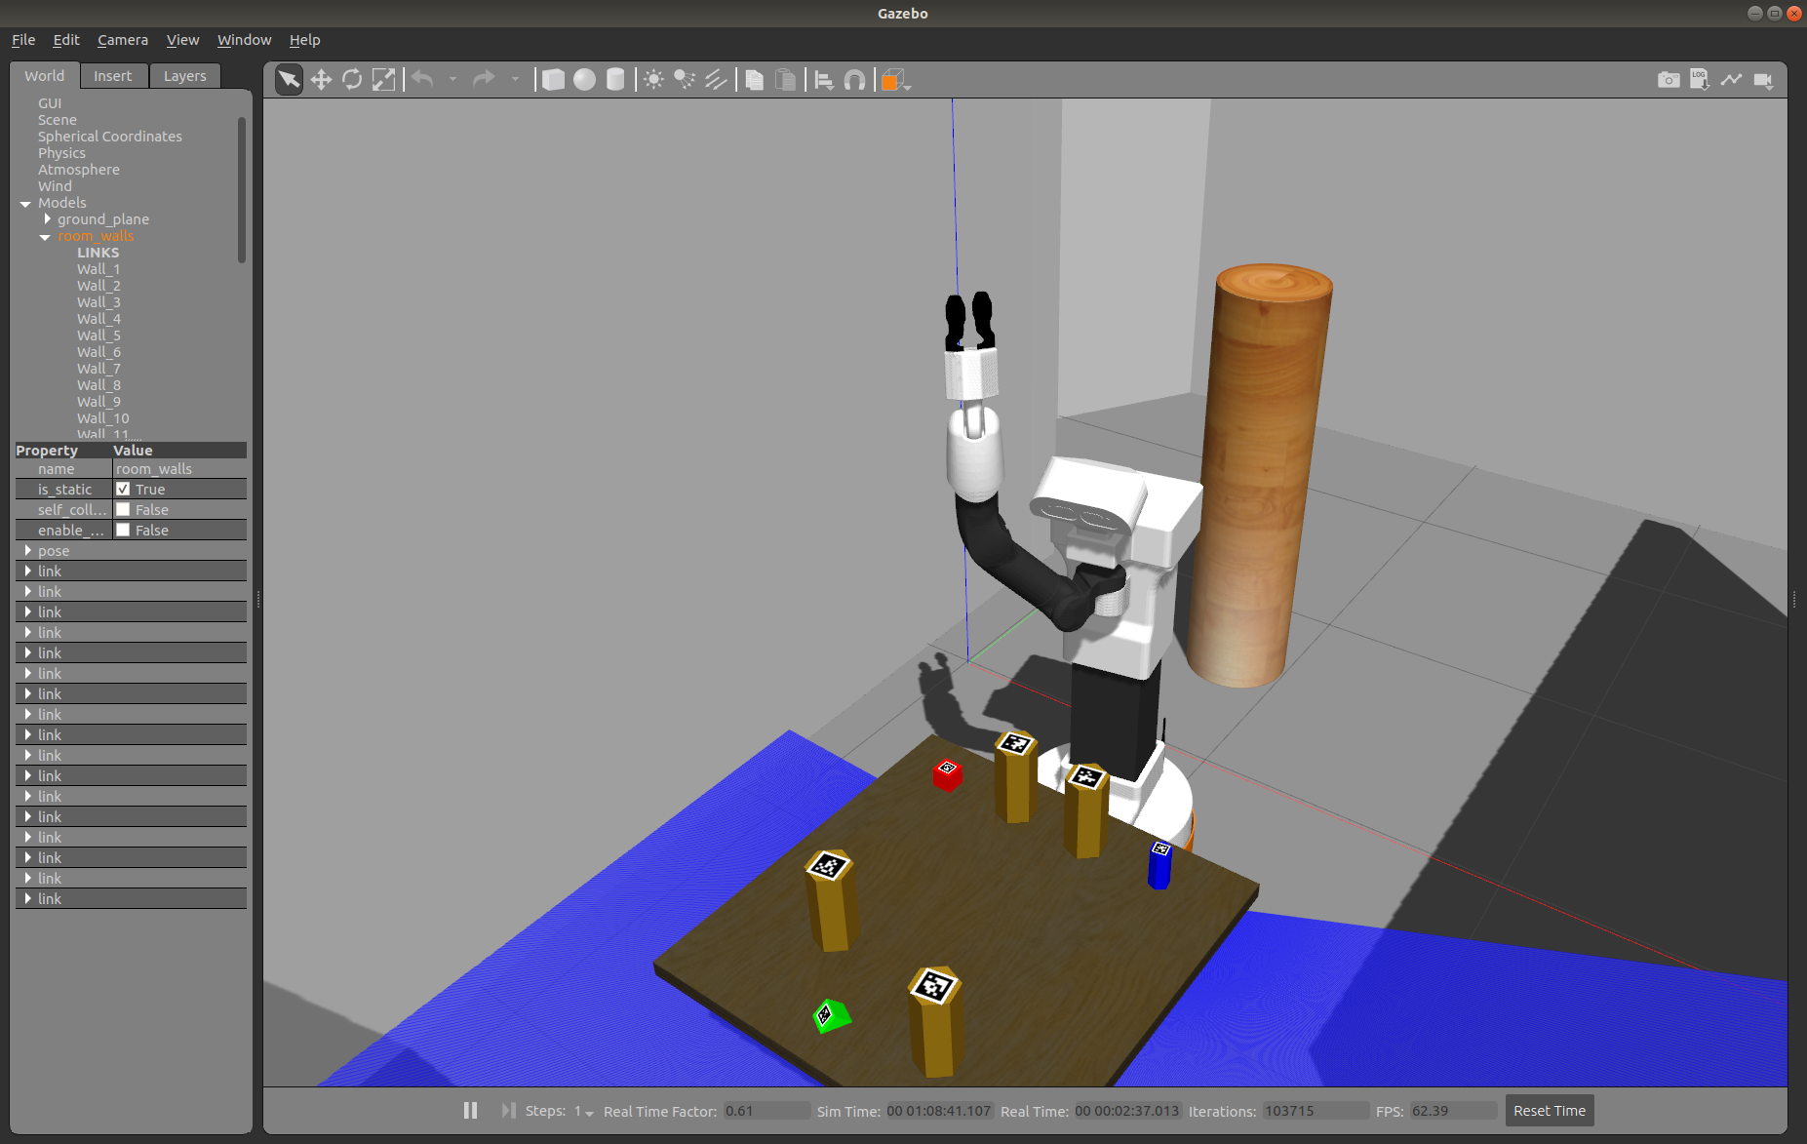
Pick – Robot configurations (1)
SAFE CONFIGURATION:
Specified in the joint space
Goals:
achieve a safe navigation;
provide enough room for the object that the robot is holding.
INTERMEDIATE CONFIGURATION:
Specified in the joint space
Goal: minimize the risk of collisions with the table and the objects.
we raised both the torso and the arm of the robot to minimize the amount of horizontal movement in the proximity of the obstacles
Notes:
‹#›

Slide 21
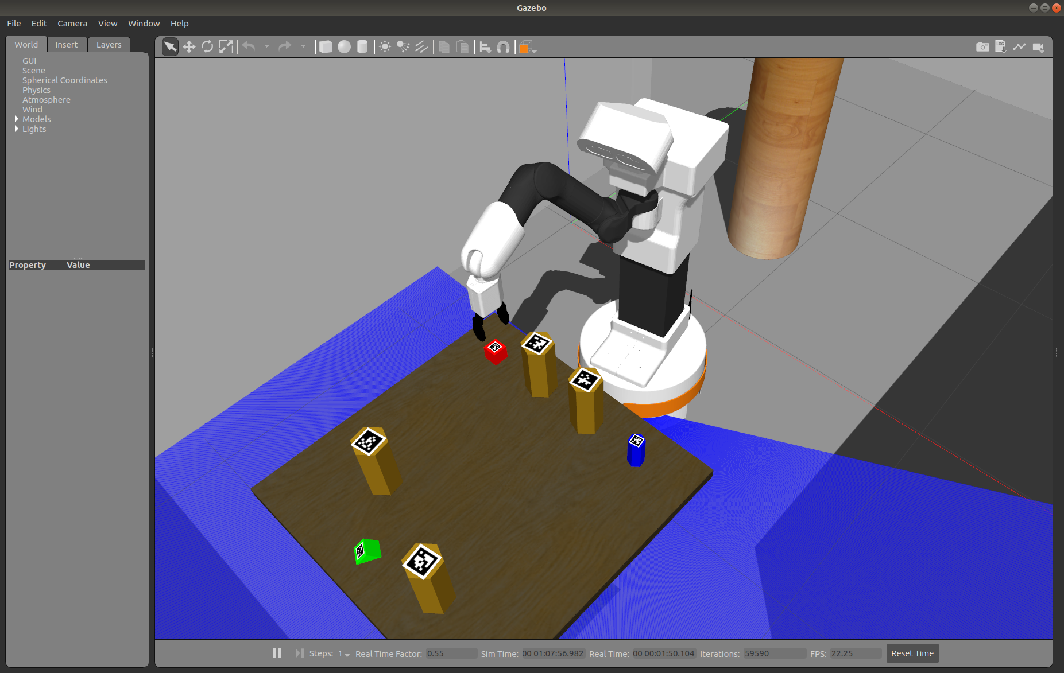
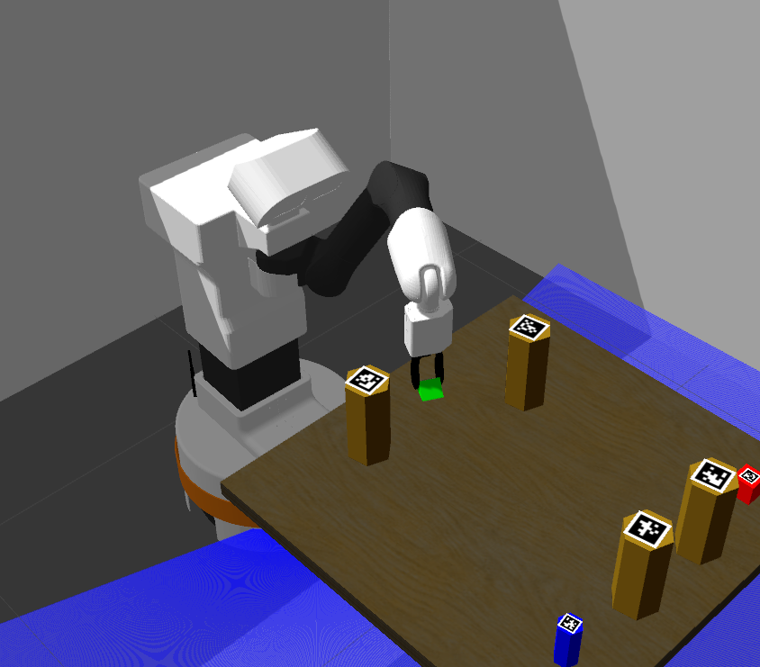
Pick – Robot configurations (2)
TARGET CONFIGURATION:
Goal: reach a position for the gripper slightly above the object to pick.
Since from the detection we’re able to get the pose of the object
use the cartesian space to directly set a target pose for the gripper instead of setting the value of each joint.
Orientation of the gripper:
perpendicular to the plane of the table;
keeps in consideration also the orientation of the object to pick.
Multiple inverse kinematic solutions:
different executions can result in different values of the joint variables.
Notes:
‹#›

Slide 22
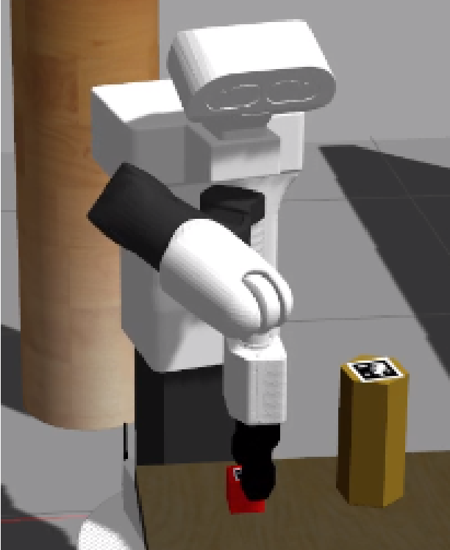
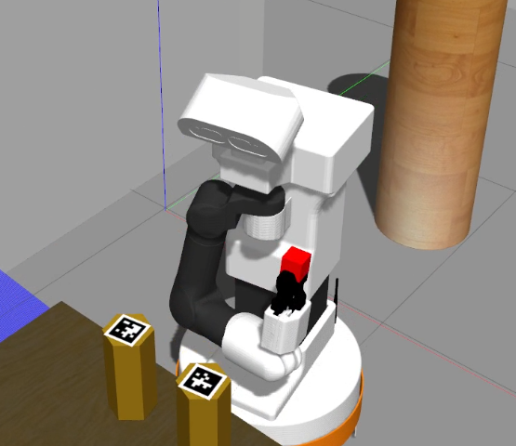
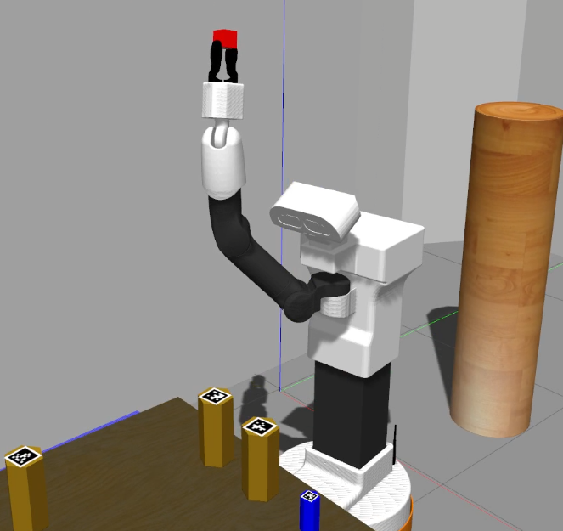
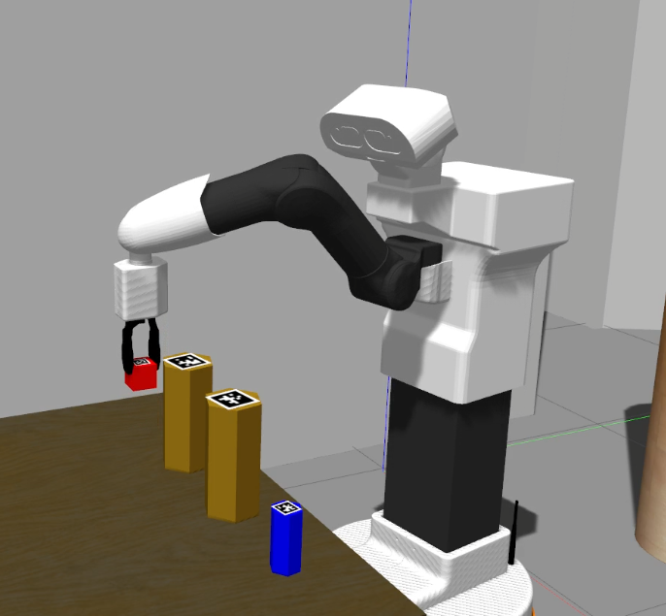
Pick – Pick sequence
CARTESIAN
PATH
SAFE CONF.
INTERMEDIATE CONF.
TARGET CONF.
Remove object from collision objects
attach links
close gripper
Notes:
‹#›

Slide 23
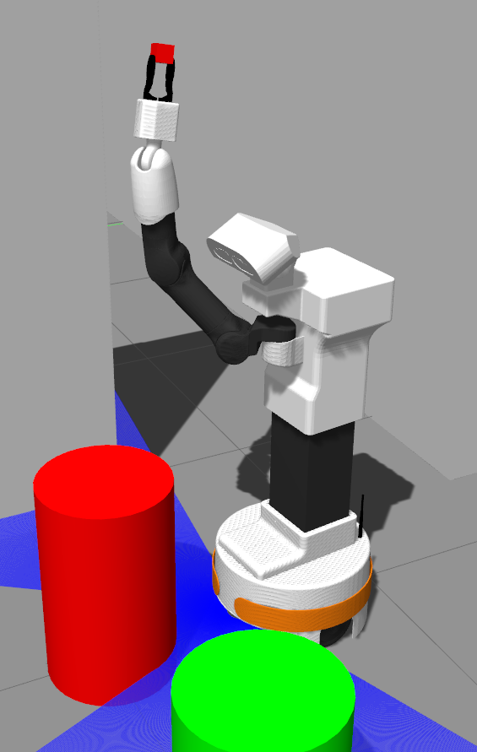
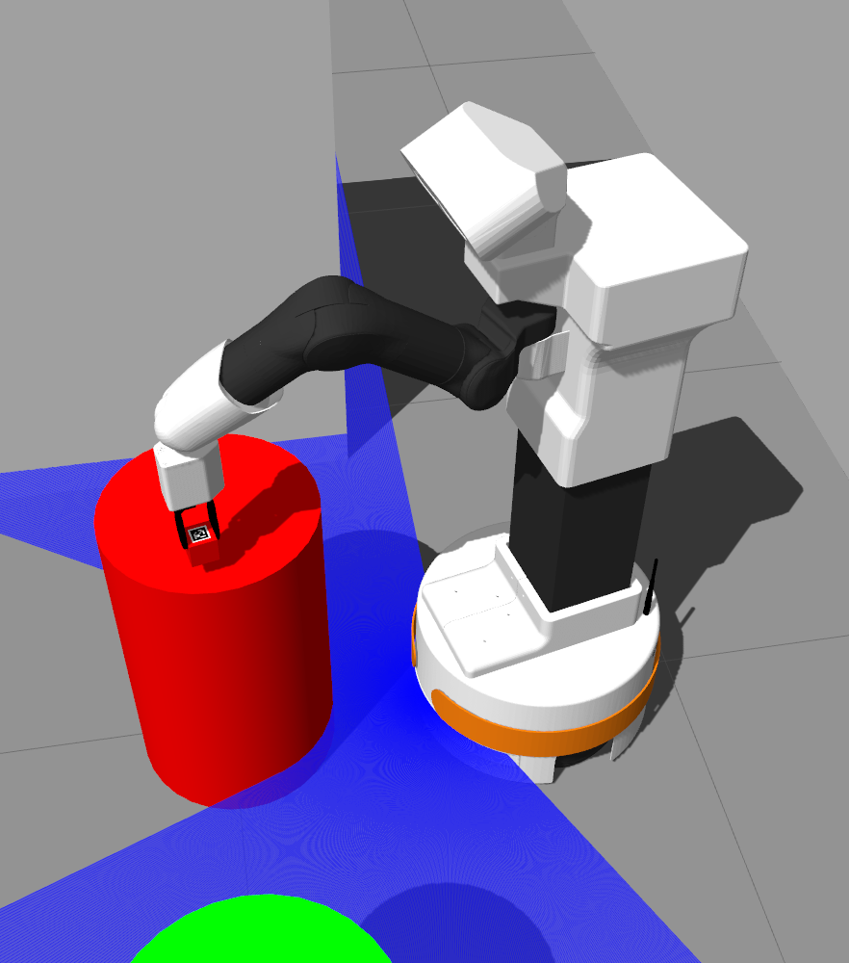
Place – Robot configurations
SAFE CONFIGURATION
INTERMEDIATE CONFIGURATION
TARGET CONFIGURATION
Notes:
‹#›

Slide 24
Place
Assumption: We computed the collision objects of the cylindrical tables measuring the dimensions using gazebo and enlarging them in order to avoid collisions.
When placing the object in the tables, we decided to release the blue hexagon from a higher position with respect to the cube and the triangle.
Notes:
‹#›

Slide 25
Assumptions & Final considerations
Given that Moveit is a probabilistic framework every execution of our program will perform the trajectories in different ways.
We assumed that the following information is known a priori:
the pose and the dimensions of every table in the map
the dimensions of every object (target or obstacle)
These values were obtained using gazebo.
Notes:
‹#›

Slide 26
Thanks for your attention !!

